Slide 1
Preliminary Design Review
Team Name: (Un) Lucky Thirteen
Team Number: 13
Team Members:
Apoorva Kharche Broderick Schwartz
Yash Shah Rashid Sarwar

Slide 2
Problem Scoping Concept Generation and Reduction
We have been asked to create a simulation that visualizes Quantum Dot applications, specifically towards energy output and absorption.
Our direct user will be a Quantum Dot Photo Voltaic solar cell fabrication lab.
1: Calculate and graph efficiencies of Cost/Toxicity (or both) against materials.
Gives data that directly relates to fabrication interests.
2: Have multiple graphs that display different combinations of given materials and the wavelengths they best absorb.
Communicates to user which materials of those input are the best for the intended application.
3: Display graphs of optimized attributes, alongside bar graph of material percentages/masses. Have button that allows user to print the results.
This will actually build a ‘recipe’ for the user and allow them to print and better share the results.
4: Have graph of cost/toxicity that is able to be changed dynamically by a single input/material (input to be changed can be selected from a pull down menu). As well as minimizing cost/toxicity of combination for user entered wavelength.
This will allow the user to take unanticipated factors into account as well as let them adjust the model for non-standard applications.

Slide 3
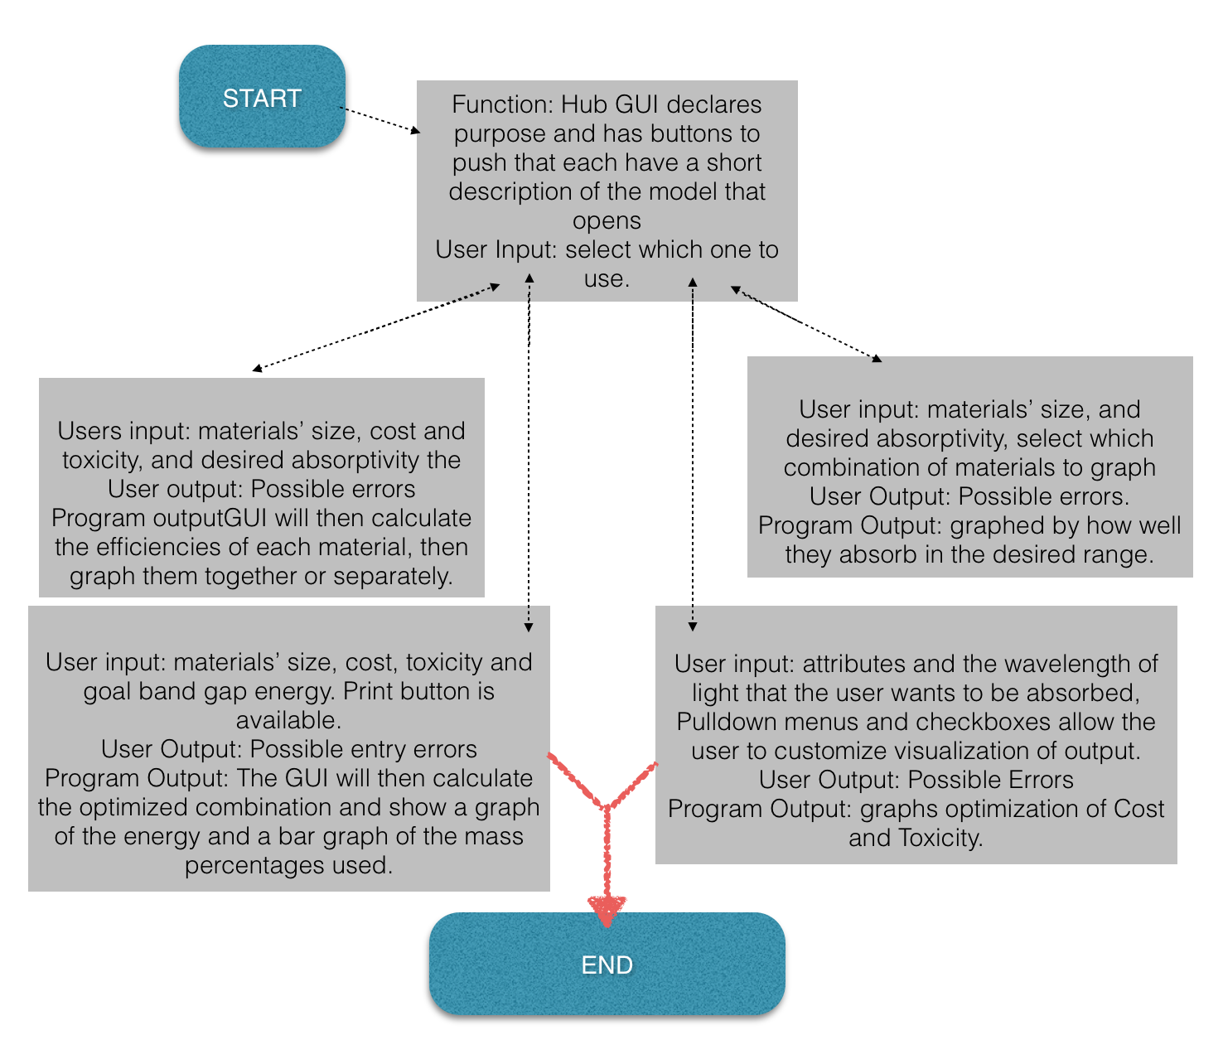

‘Second’ GUI:
‘First’ GUI:
‘Third’ GUI:
‘Fourth’ GUI:
Should not spend more than 1-2 minutes talking on this slide
Notes:
Discuss for each GUI screen:
Programmatic inputs/outputs
User inputs/outputs
Each teammate describe what his/her model/simulation will do (one sentence preview)

Slide 4
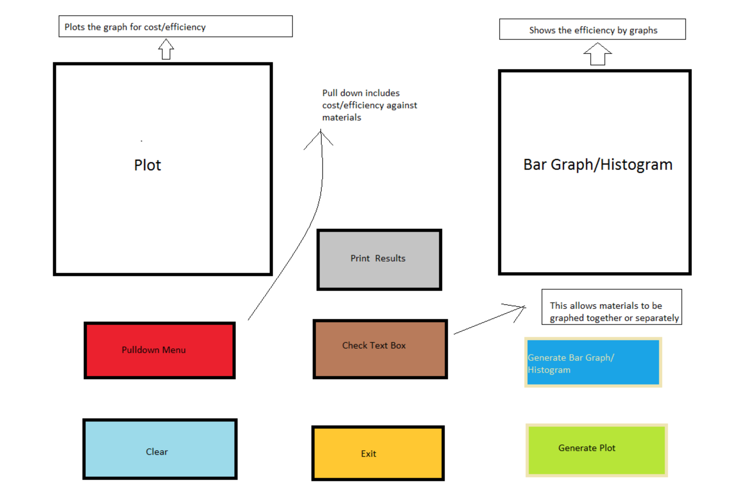
Insert your rapid prototype slides (M4)
Use paste option “use source formatting” to make sure slide formatting carries over
NOTE: Be sure to test slides once copied, to ensure that no hyperlinks broke in the transfer
Each teammate should spend 1 minute walking us through his/her GUI for a total of 4 minutes per team!
Notes:
A: Inputs: Materials’ size, cost and toxicity, and desired absorptivity.
Outputs: Two plots, one of cost/efficiency graph, one of the relative efficiency of the individual materials in a bar graph.
Other actions: The users can also select individual materials to graph.
B: We plan to use this equation to calculate band gap energy. Eg(Qdot) = Eg(bulk) + (h^2/4mer^2) – (1.8e^2/4pi(epsilon)(epsilon0)r).
We will also use basic efficiency mathematics to determine the efficiency. We will also use our mathematical model to minimize the cost and toxicity in the selection of the materials as it pertains to the simulation.
C: Each input field will have a check to make sure that the user has input a valid quantity. Also that there is a selection made in each mandatory field.
D: There will be pop-up instructions for each field that does not have an informative string available.
E: Rashid Sarwar will program this GUI.

Slide 5
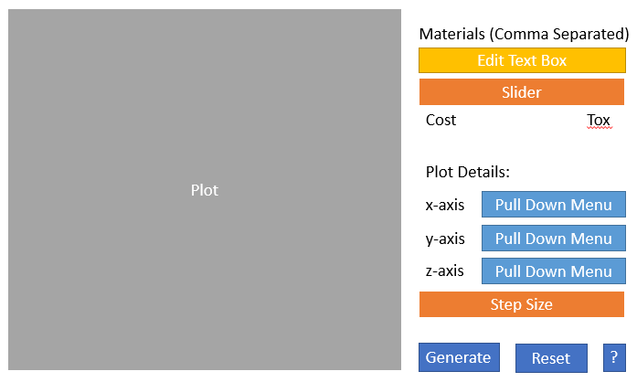
Notes:
A: User will input which material (by number) are available for the purposes of the simulation. The user will also the target band gap energy. The user will use a slider to select the relative importance of cost/toxicity. The user will also select a “step size” indicating the increments used in the generation of the graph. A graph will be generated based on user selection of axis properties. These may include concentration of one of the materials, cost, or toxicity; a none option will also be provided for the z-axis. The user will be able to see how the given properties relate with regards to a particular configuration, e.g. how cost and toxicity vary with concentration of a particular element.
B: The gui uses a similar mathematical model to the one in the modeling sets earlier in this course. It allows the variation (forcing a required usage in a desired quantity) of up to two materials in the optimization. It is being forced as such and then plots accordingly.
C: the only error checking required is ensuring the materials list is appropriate.
D; Help documentation is provided by the help button.
E: Apoorva Kharche

Slide 6
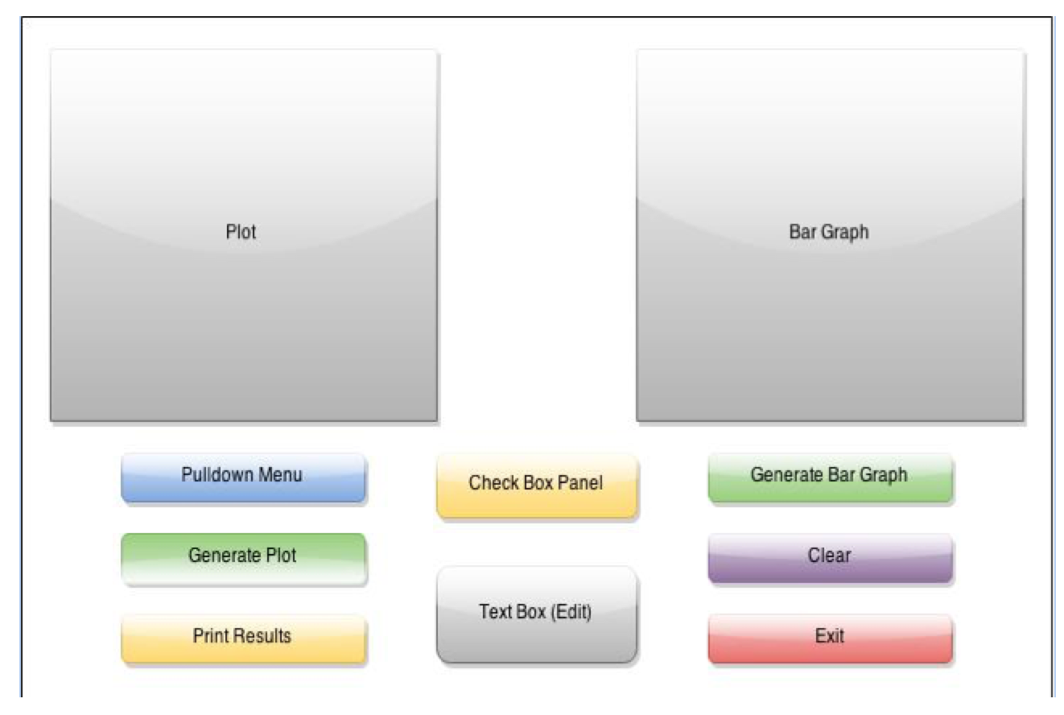
Insert your rapid prototype slides (M4)
Use paste option “use source formatting” to make sure slide formatting carries over
NOTE: Be sure to test slides once copied, to ensure that no hyperlinks broke in the transfer
Each teammate should spend 1 minute walking us through his/her GUI for a total of 4 minutes per team!
Notes:
A: The user will enter materials’ size, cost, toxicity and goal band gap energy.
The user will see two graphs one of the optimization curve and one of the material percentages used.
The user can select material to graph on optimization curve and also print result. User can select attribute(s) to optimize.
B: This GUI will use our Mathematical model to optimize the attributes selected, as well as use the following equation to calculate band gap energy:
Eg(Qdot) = Eg(bulk) + (h^2/4mer^2) – (1.8e^2/4pi(epsilon)(epsilon0)r).
C: The program will check to see that the inputs are within an appropriate range as well as if there are enough entries.
D: Pop-up instructions will be written for each entry field expounding on what each portion does.
E: Yash Shah will be responsible for coding this GUI.

Slide 7
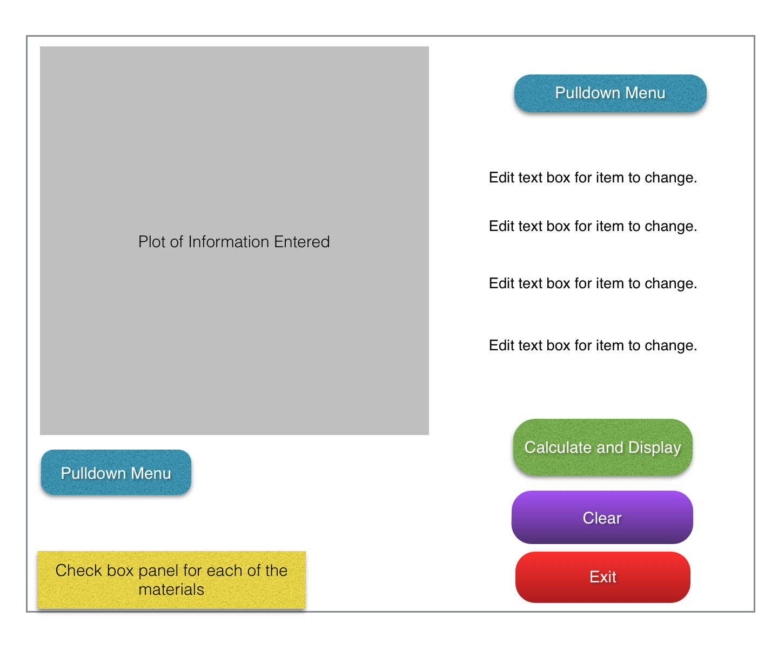
Insert your rapid prototype slides (M4)
Use paste option “use source formatting” to make sure slide formatting carries over
NOTE: Be sure to test slides once copied, to ensure that no hyperlinks broke in the transfer
Each teammate should spend 1 minute walking us through his/her GUI for a total of 4 minutes per team!
Notes:
A: GUI will initially have the edit boxes open for first iteration of material inputs. The user will input the materials’ cost, toxicity and sizes. As well as the goal band bap energy.
The user will see a graph of the selected options.
The user can then change the attributes of any of the materials or the band gap energy as well as enter a goal wavelength of absorption.
B:We will be using our mathematical model from the previous section to calculate various optimized attributes. We will also be using this equation to calculate the goald band gap energy: Eg(Qdot) = Eg(bulk) + (h^2/4mer^2) – (1.8e^2/4pi(epsilon)(epsilon0)r)
C: Each input will be tested to see that it is within the allowed ranges for each value as well as to see if there are enough inputs to complete the calculations desired.
D: The user will be supplied with pop-up descriptions for each entry field.
E: Broderick Schwartz will be responsible for the programming of this GUI.

Slide 8
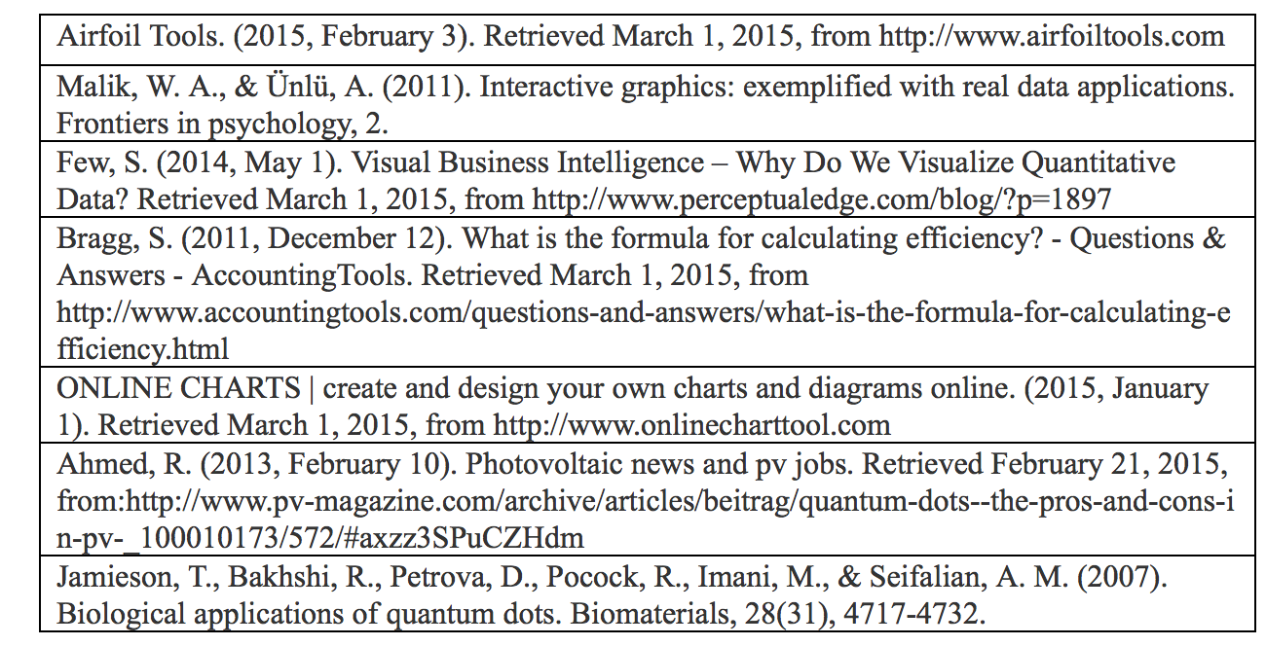
Citations

Slide 9
Questions & Feedback
Please ask any questions you may have.

